Slide 1
MGS 723: Geodynamics
Class 19: Fluid Mechanics II
(Channel flow I)
Main reference for today: Katz and England, University of Oxford notes

Slide 2
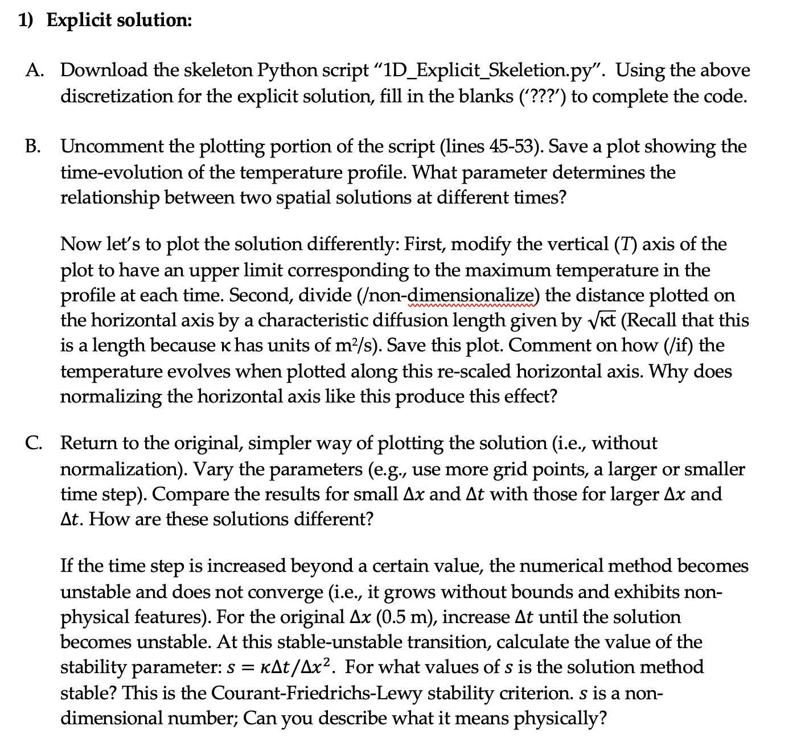
Homework #3

Slide 3
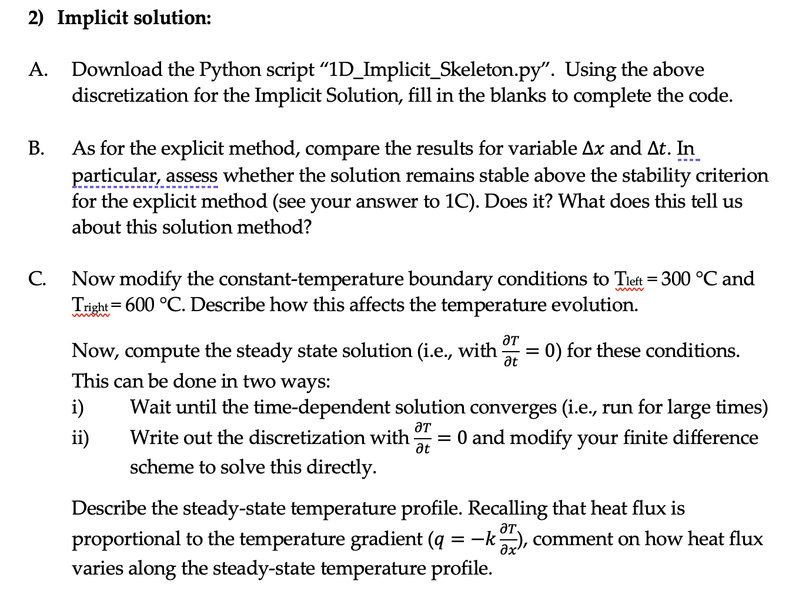
Homework #3

Slide 4
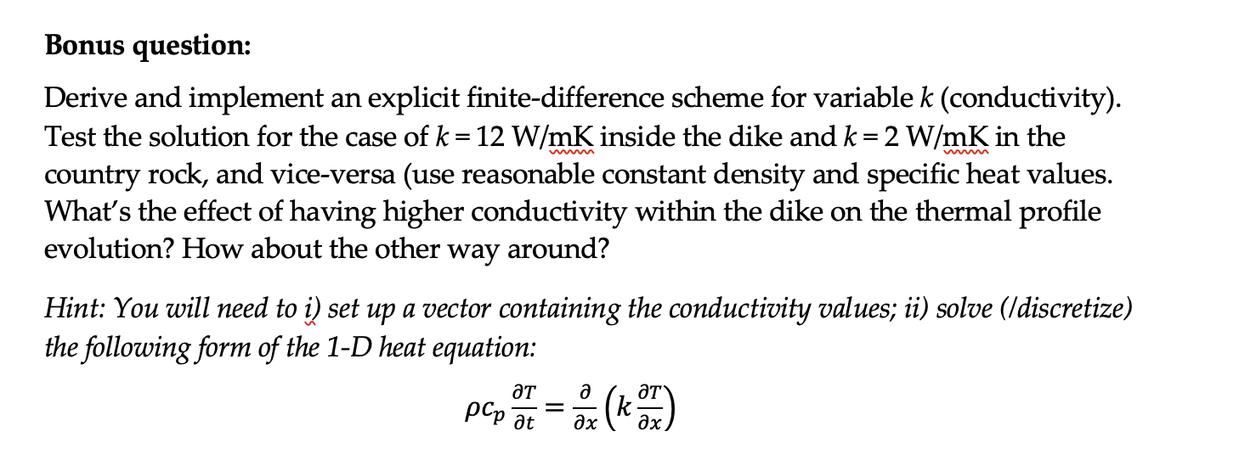
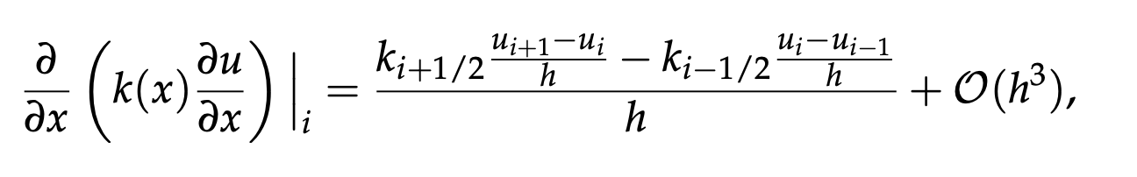
Homework #3

Slide 5
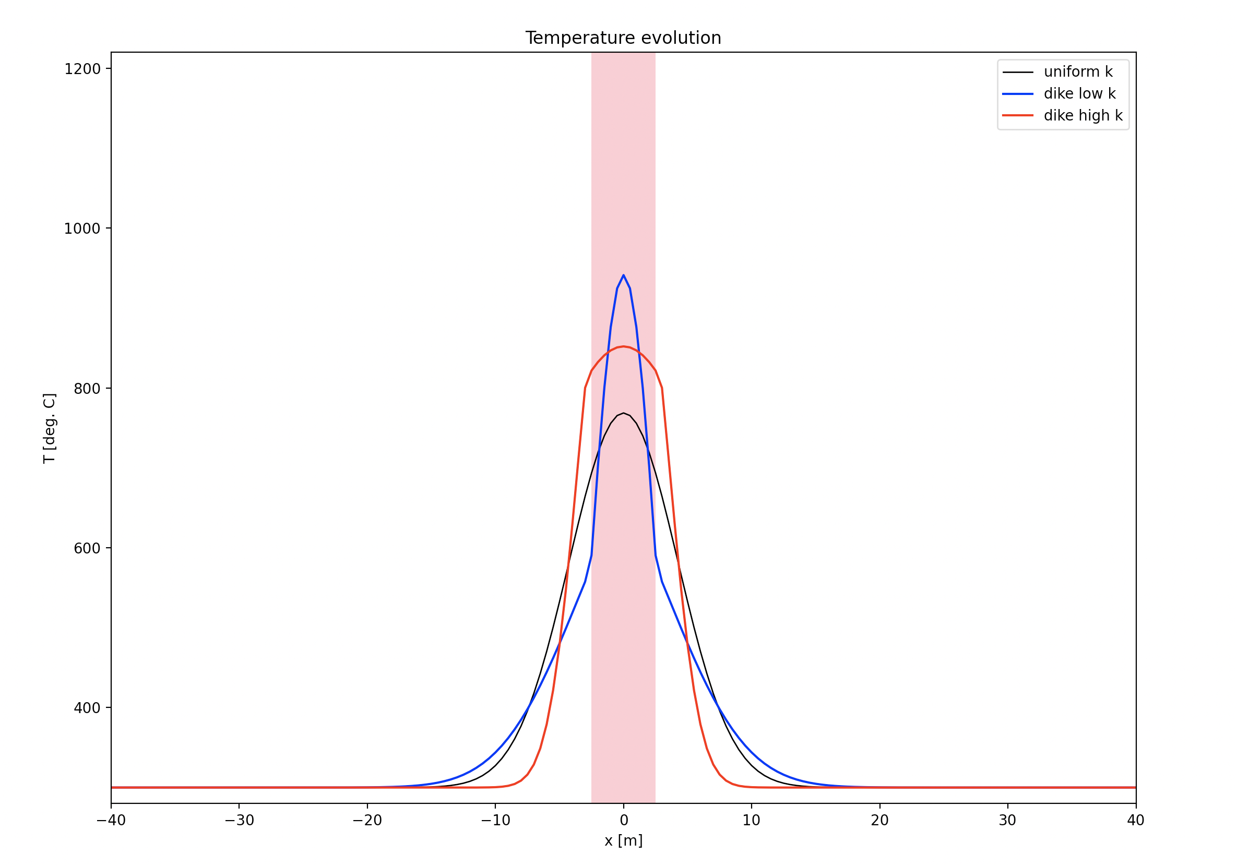
Homework #3

Slide 6
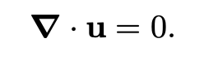

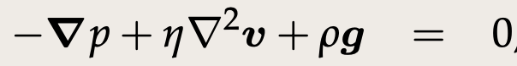
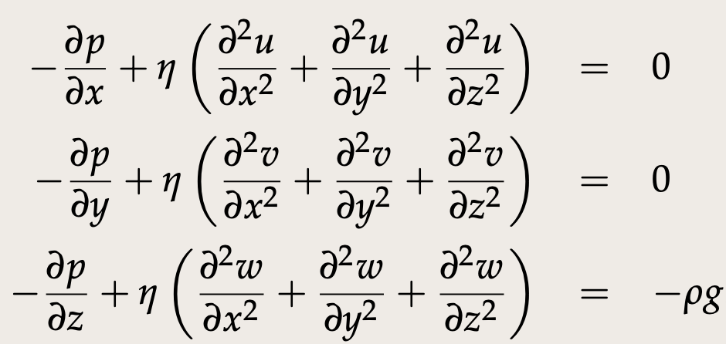
What we derived in the last session:
Stokes flow for incompressible, Newtonian fluid
Conservation
of mass
Conservation
of momentum
Vector form:
In full (Cartesian):

Slide 7
What we derived in the last session:
Stokes flow for incompressible, Newtonian fluid
Conservation
of mass
Conservation
of momentum
Vector form:
In full (Cartesian):
Let’s apply this to a very simple problem: 1-D channel flow

Slide 8
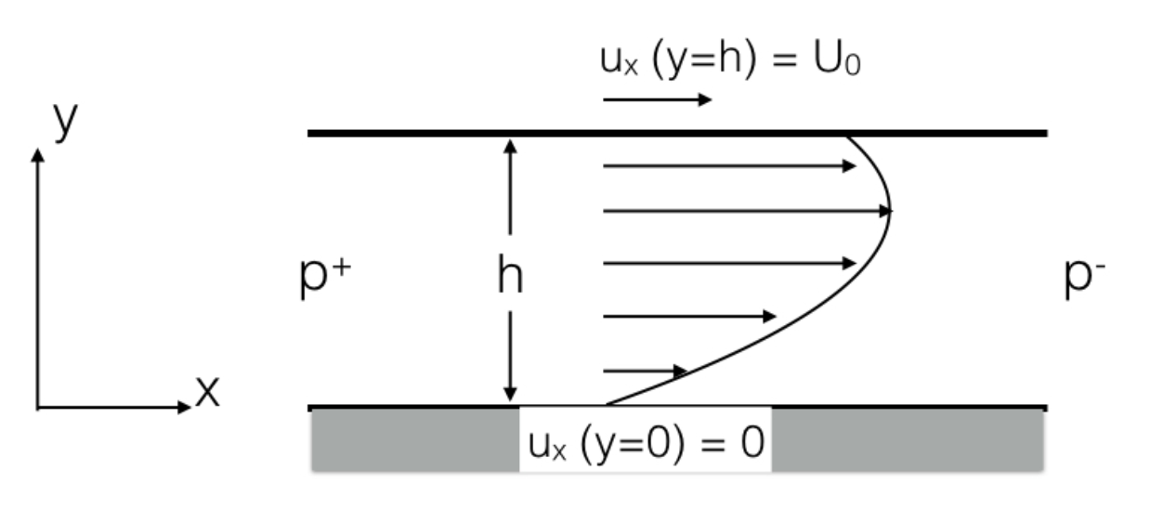
1-D Channel flow
1-D channel flow driven both by moving boundaries and a pressure gradient.
Katz and England, Univ. of Oxford

Slide 9
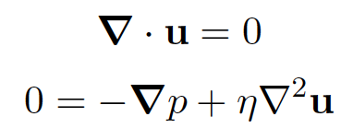
1-D Channel flow
1-D channel flow driven both by moving boundaries and a pressure gradient.
In the Stokes equations (Newtonian) fluid, we will set the inertial and gravity terms to zero:
Katz and England, Univ. of Oxford

Slide 10
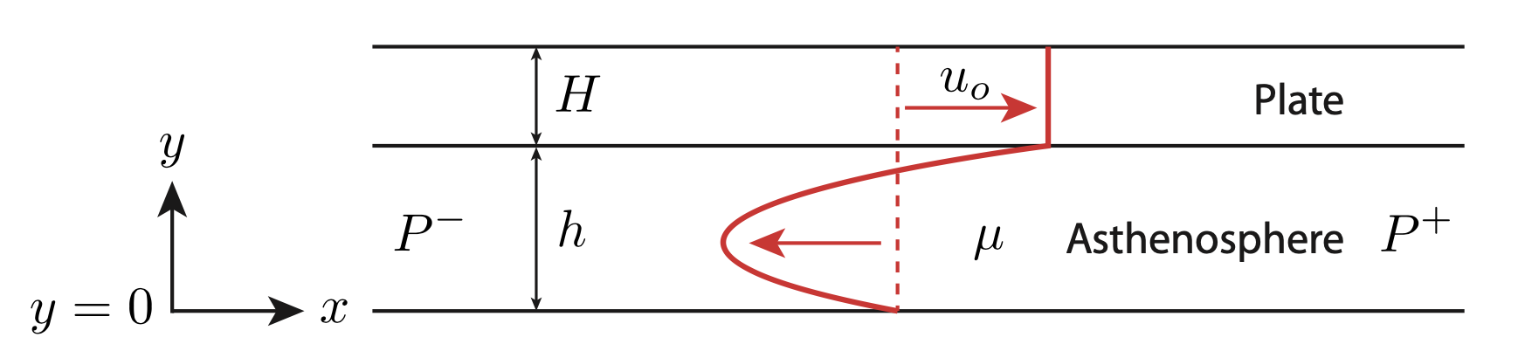
1-D Asthenosphere counter-flow
1-D counter-flow driven by moving plate and a pressure gradient.
We’ll also consider an alternative, but similar, case where flow accommodates the movement of a finite thickness tectonic plate.
Force balance the same (flow driven by pressure gradient and velocity boundary condition) but need to be careful to make sure mass is conserved.
Katz and England, Univ. of Oxford

Slide 11

To the stylus…
Derive 1-D channel flow and counter/return flow solutions

Slide 12
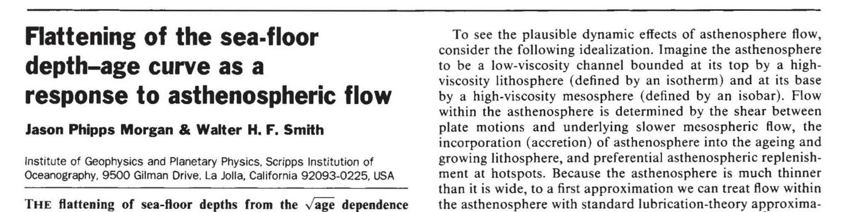
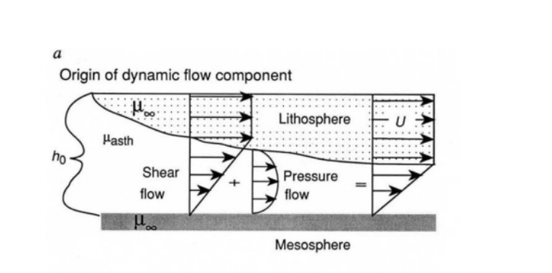
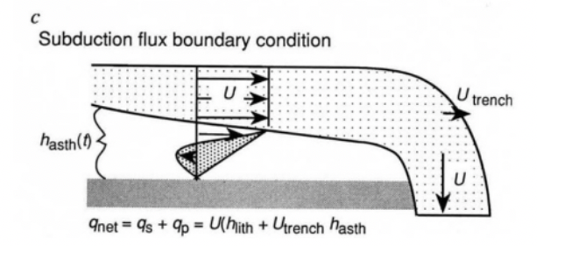
Applications in geodynamics
e.g., Phipps-Morgan and Smith, 1992

Slide 13
Applications in geodynamics
e.g., Phipps-Morgan and Smith, 1992
Pressures proposed as an explanation for “sea floor flattening”
We now think that these pressures are too large. Small scale convection removal of plate more likely.

Slide 14
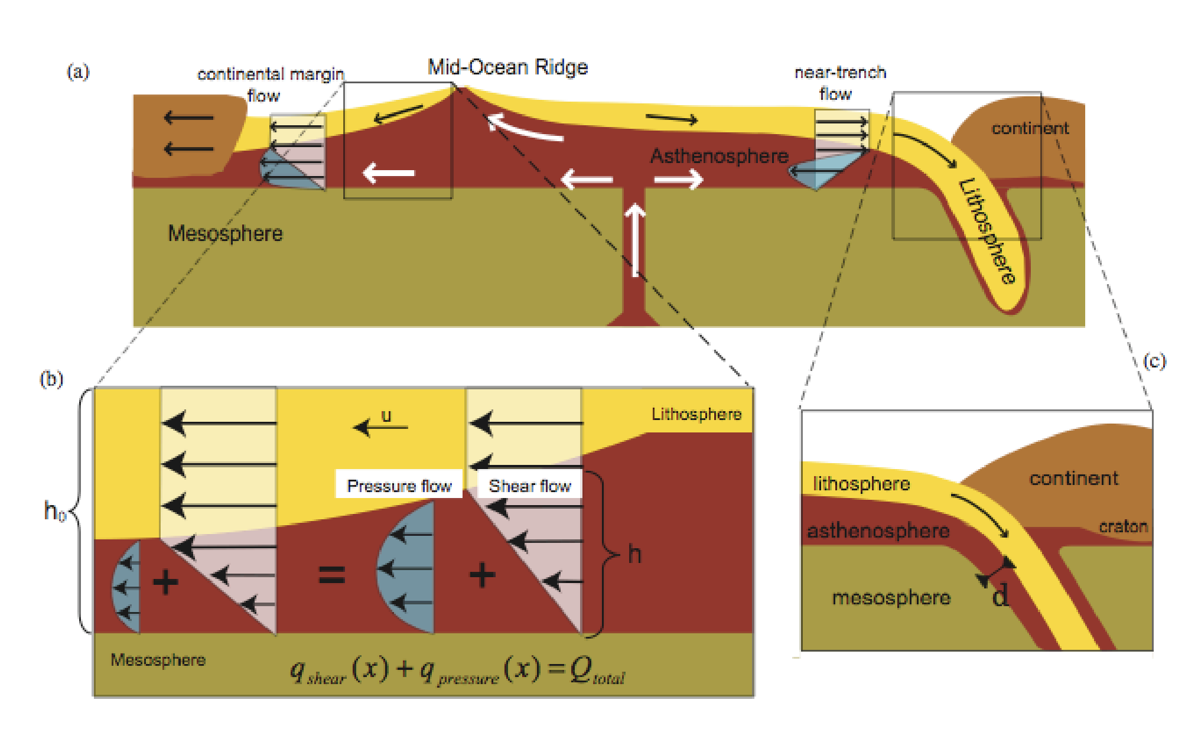
An extreme view
Yamamato et al., 2007

Slide 15
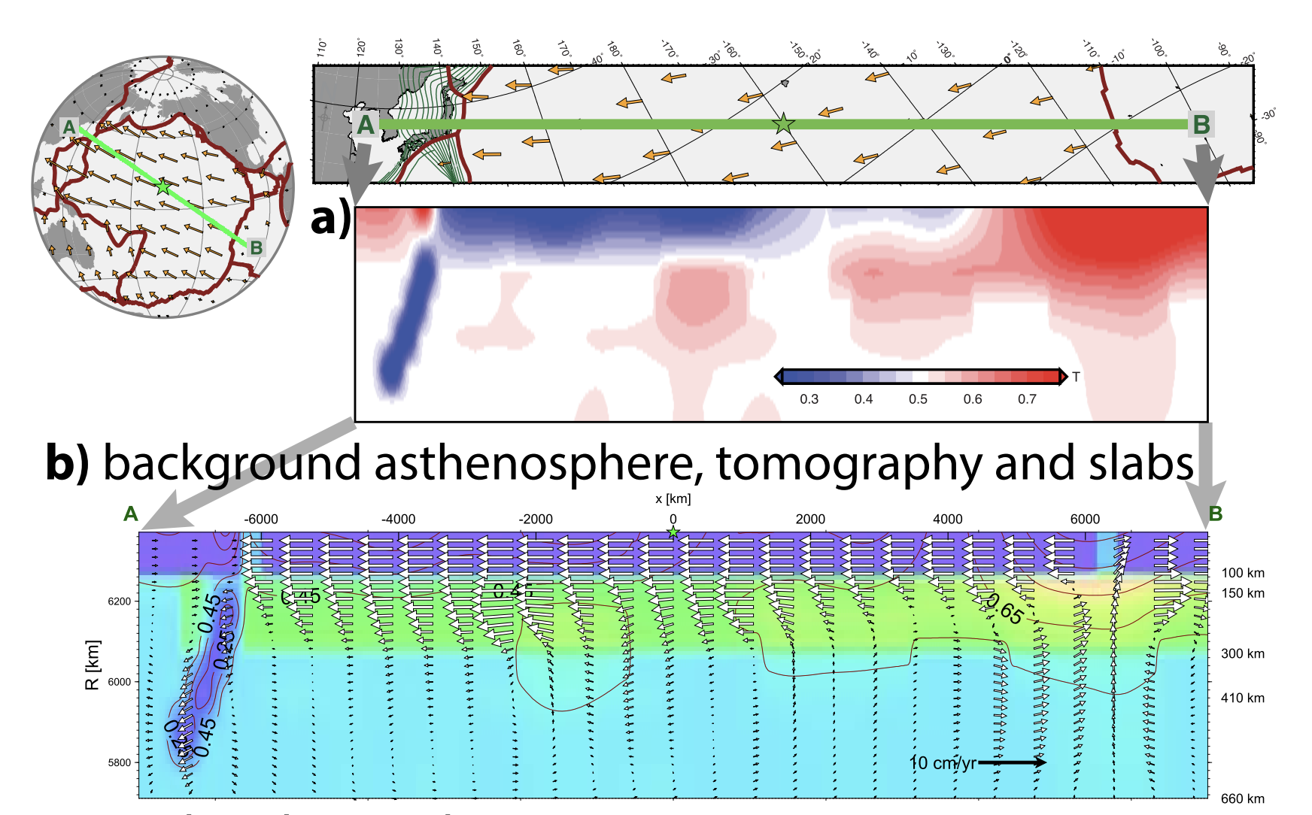
More recently
There is a relatively weak asthenosphere (low seismic velocity) beneath oceanic plates, but not weak enough to solely isolate flow.
Maybe Something more like this:
Becker, 2017

Slide 16
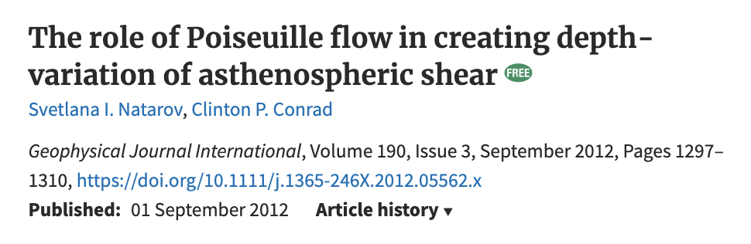
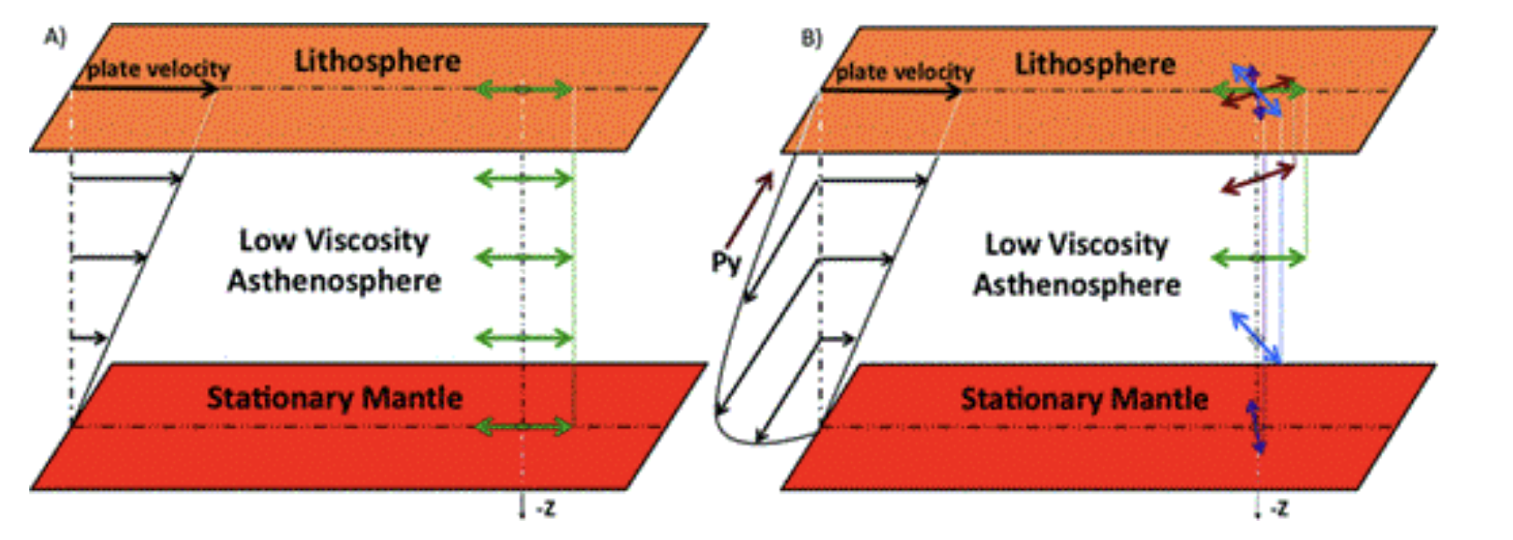
Can use this framework to interpret seismic observations

Slide 17
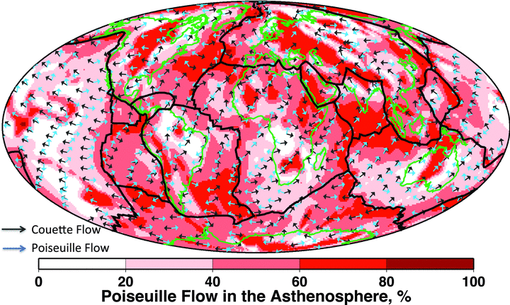
Can use this framework to interpret seismic observations

Slide 18
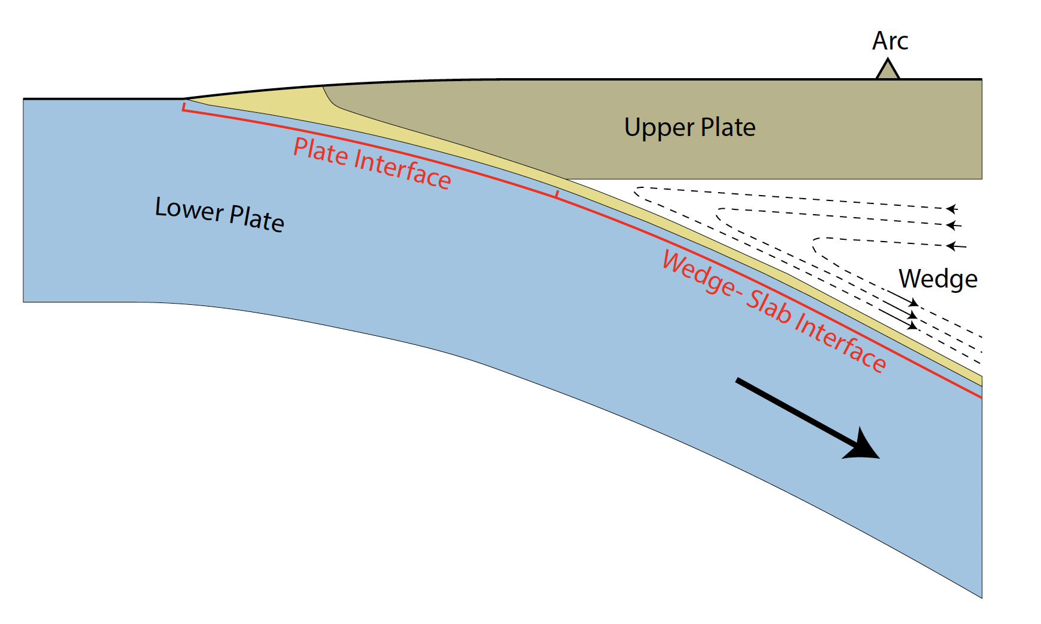
Another application: Flow in subduction channels
Can use VOP and VSP as boundary conditions and figure out whether material flows up or down.
In order to address this, what’s missing from our simple approach?
Philip England, Univ. of Oxford

Slide 19
Take homes:
We can simplify the Stokes Equation to gain intuition about simple problems.
A classic example is channel flow:
Flow driven by pressure gradients (Poiseulle flow) and/or plate shear (Couette flow).
Neglects lateral variability, density anomalies, and for a thin channel.
An extension: Asthenosphere counter flow. Requires also ensuring that mass is conserved.
A prolific model for Earth’s mantle just after dawn of plate tectonics.
Now used as a simple end-member to interpret more complex/realistic situations

